Slide 1
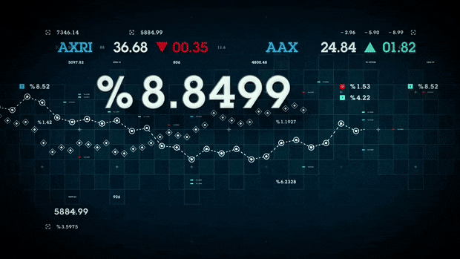
Stock movement prediction
Stock movement prediction by time-series forecast techniques

Slide 2





Meet Our Data Team
Rong Fang
Luyao Li
Sarah Liu
Basil Latif
Manodhar Allu

Slide 3
Analytics Framework
Modeling & Prediction
Data Collection
Exploratory Data Analysis
Insights
New appreciation for technology stocks
Quandl API
Github
Understanding Fluctuations
Used 3 Modeling Techniques
Searched for news that would explain market events
Studying stocks over time and predicting their future movement by time series forecast techniques like FB Prophet, Long Short Term Memory (LSTM) and Monte Carlo simulation

Slide 4
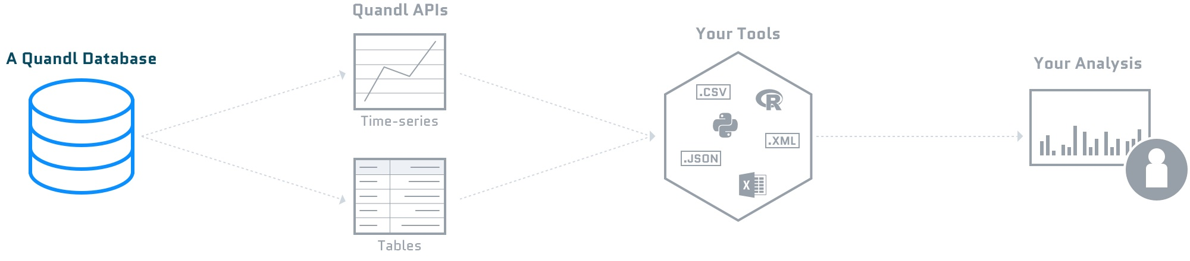
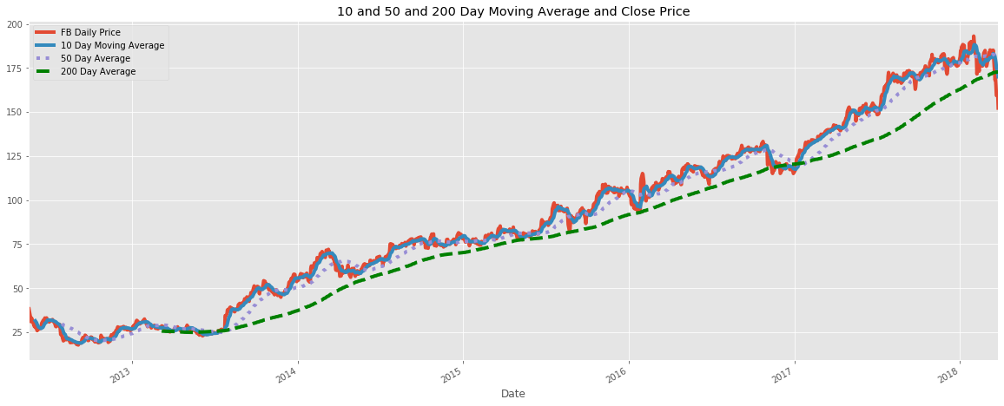


Data Collection
Sample Quandl Workflow:
Imported into Python from csv
Did visualization and modeling in Jupyter notebooks
API Key gives unlimited access
Accessing Stock Data:
-7 lines of Python
-Saved to a csv
-No data processing req’d
Result is clean data
Stored in Github

Slide 5
Exploratory Data Analysis

Slide 6

EDA

Slide 7
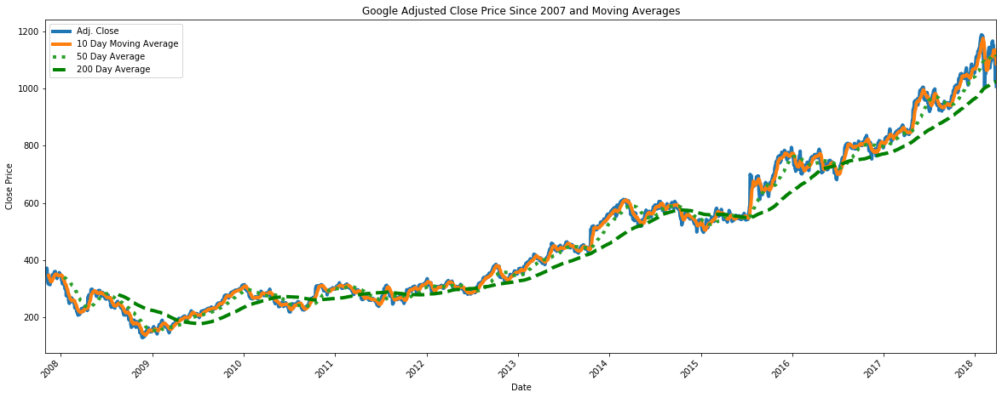
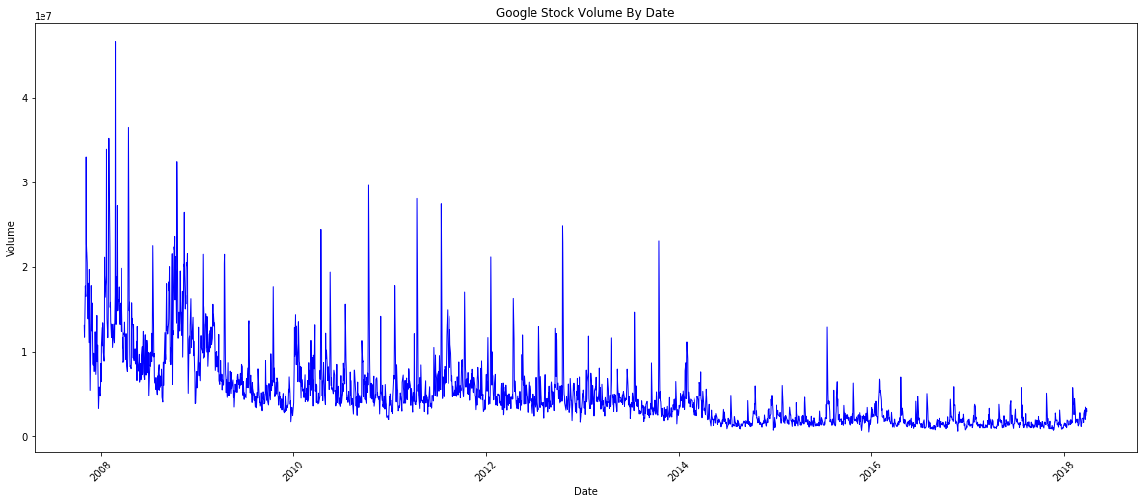
Google Price & Volume Chart
Google issues a $567 dividend to protect founder voting power
Volume is trending downward as price goes up
Notes:
https://support.sigfig.com/hc/en-us/articles/202586324-What-happened-during-the-Google-Stock-split-
Stock price can be driven by policy
Volume can help confirm price trends that have already formed or serve as a warning for potential trend reversal
As Price goes up, volume is trending downward. Low volume reflects a lack of confidence from investors. When price increased and volume went down, its a bearish market
If a volume is decreasing, the current trend will probably not continue and a reversal may be imminent

Slide 8
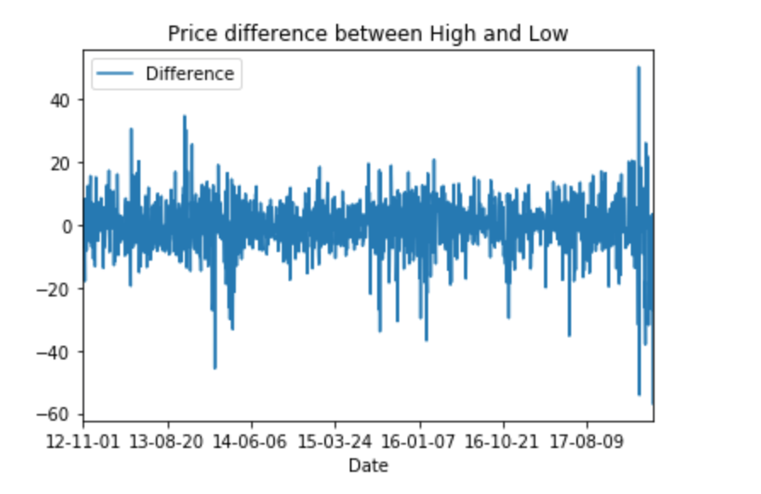
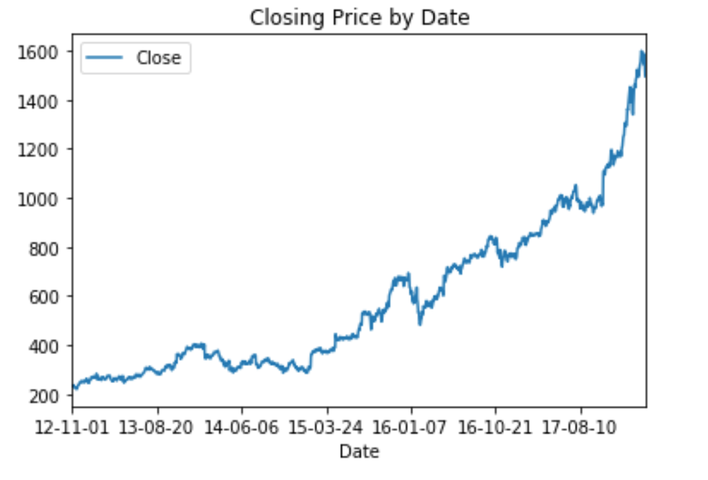
Google stock trends
Drop due to Amazon eating some ad space
Price increase due to strong earnings
Google dividend in April 2014
Due to disappointing revenues
Youtube was facing a full-scale advertising boycott
Notes:
Stock price is driven by earning, policy and market sentiment
Google split its stock in April 2014, which created the A and C shares. So the number of shares doubled and the stock price went down

Slide 9

EDA

Slide 10
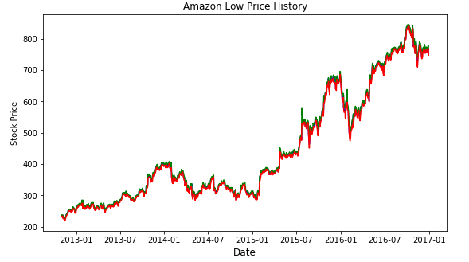
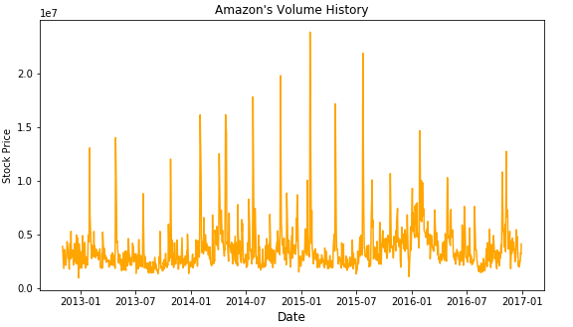
Amazon Price and Volume chart
Amazon’s sales raised from 64 billion to 72 billion as it launched its Alexa-powered devices
Significant drop due to disappointing earnings in 2016
Alexa powered devices & AWS business
Notes:
Stock price might be driven by News and holiday trends

Slide 11
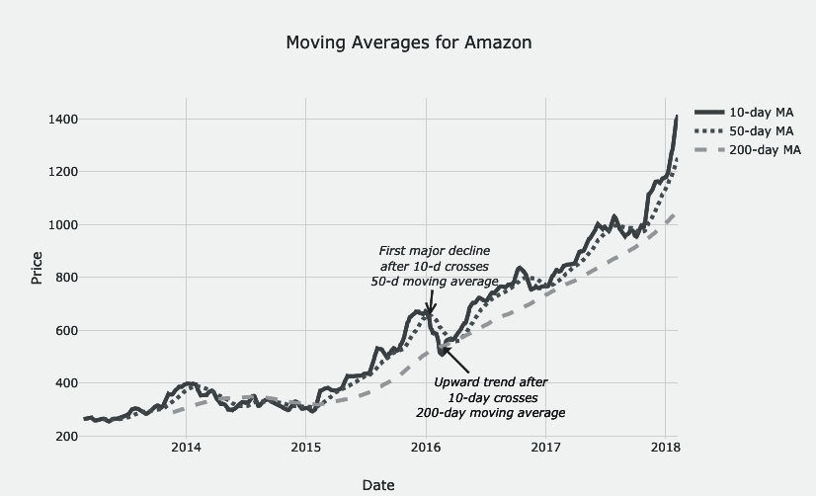
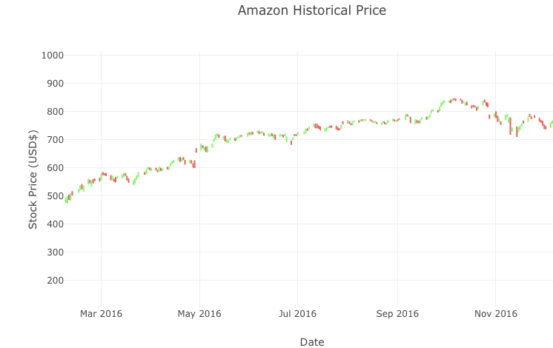
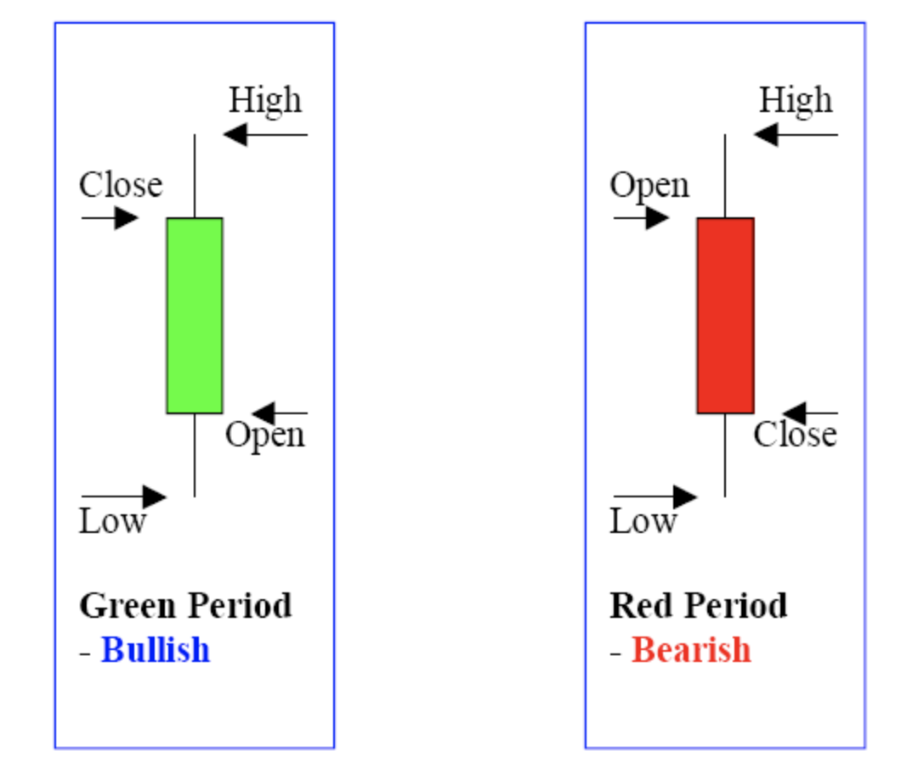
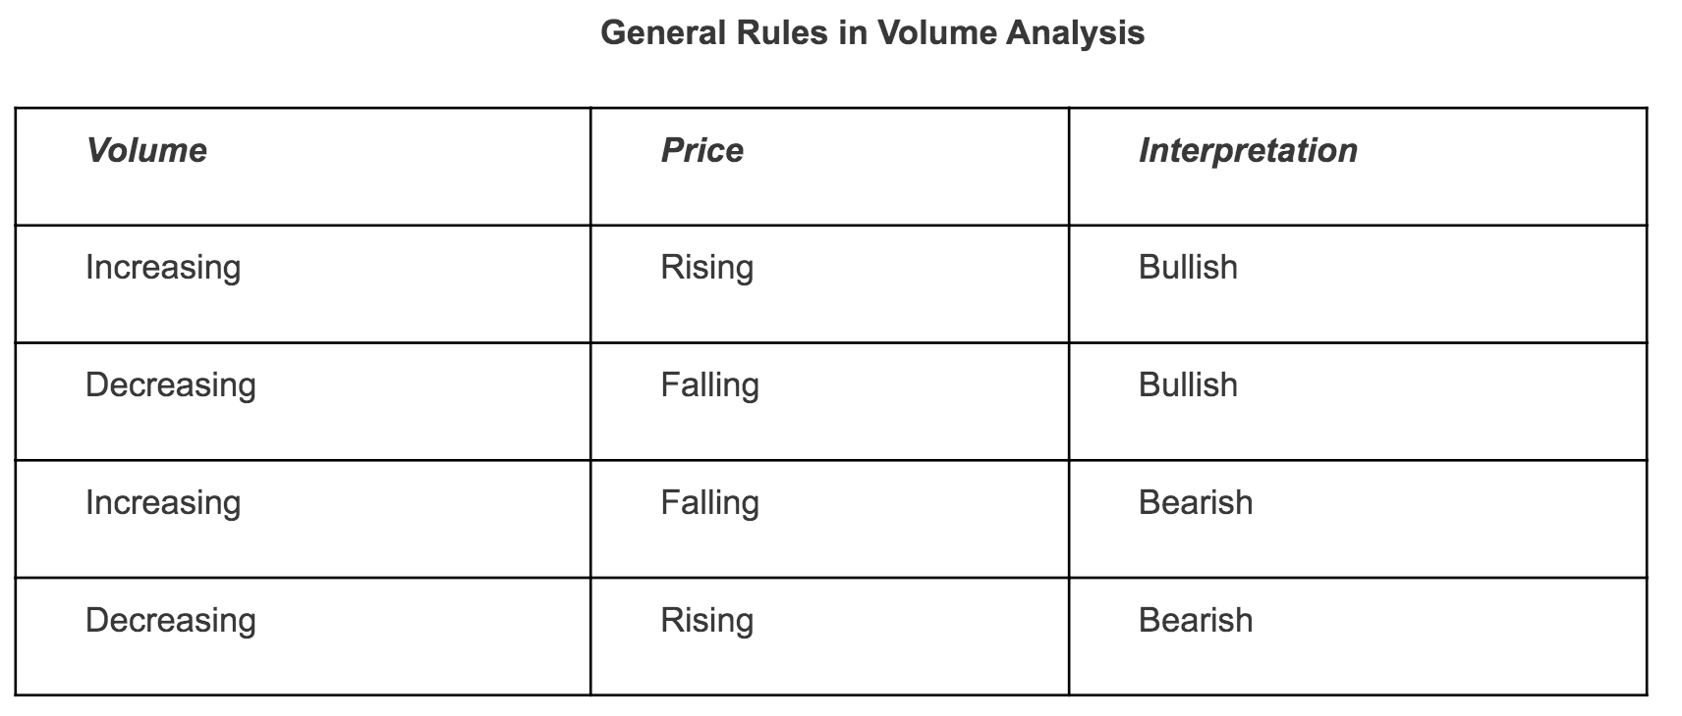
Amazon Stock Behavior
Notes:
Stock price went up after Thanksgiving, Black Friday and Cyber Monday due to either people’s shopping habits or Amazon pushed for the holiday promo deals.

Slide 12

EDA

Slide 13
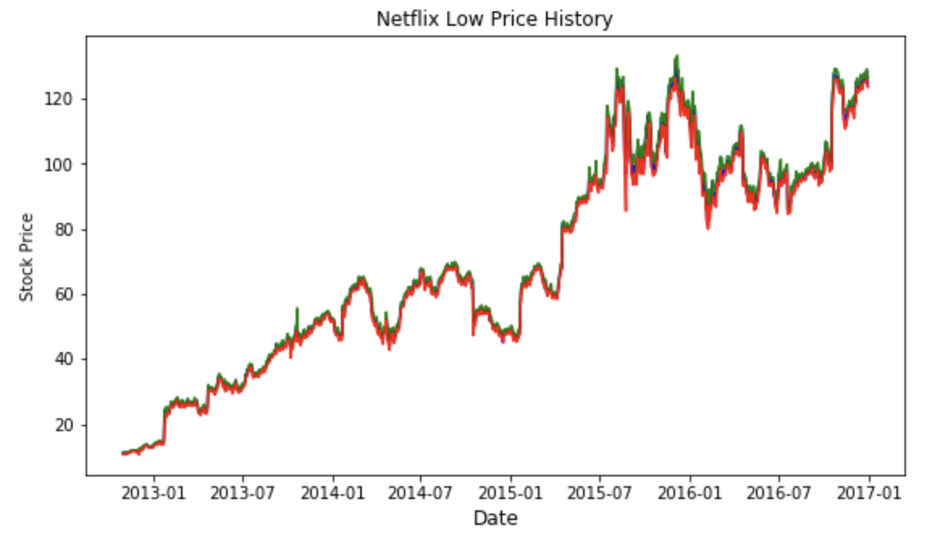
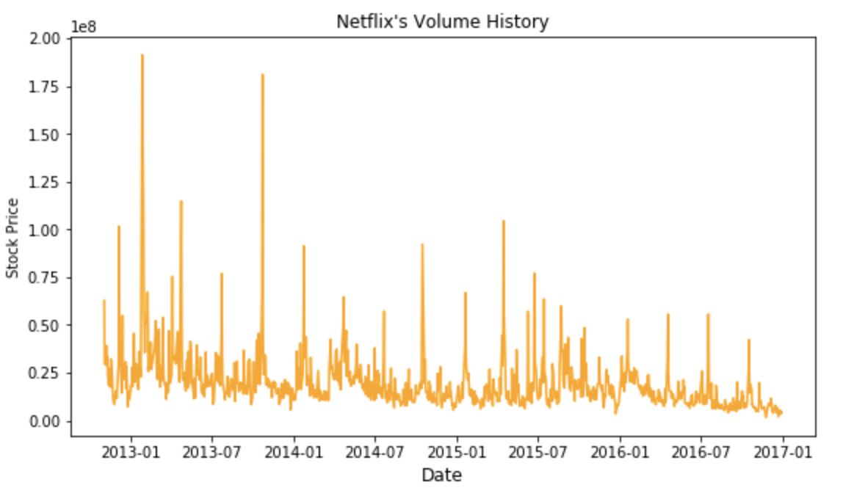
Netflix Price and Volume chart
Netflix raising the price of its monthly plan from $9.99 to $11.99
Notes:
Stock price might be driven by change in pricing
Stock price continues to go up but with a decrease in volume. This signals to investors the bullish trend in netflix might soon end.

Slide 14
Future Stock Predictions with Facebook Prophet

Slide 15
How FB Prophet works
Prophet is a procedure for forecasting time series data based on an additive model where non-linear trends are fit with yearly, weekly, and daily seasonality, plus holiday effects.
y(t)= g(t) + s(t) + h(t) + εt
Trends - g(t)
Seasonality - s(t)
Holidays - h(t)
Piecewise linear or logistic growth curve for modeling non-periodic changes in time series
Periodic changes (e.g. weekly/yearly seasonality)
Effects of holidays (user provided) with irregular schedules

Slide 16

Advantages
Accurate
Robust to missing data and shifts in trends and typically handles outliers
Fast
Very fast, since it’s built on STAN, a programming language for statistical inference
Easy to handle
Easy procedure to tweak and adjust forecast while adding domain knowledge or business insights

Slide 17
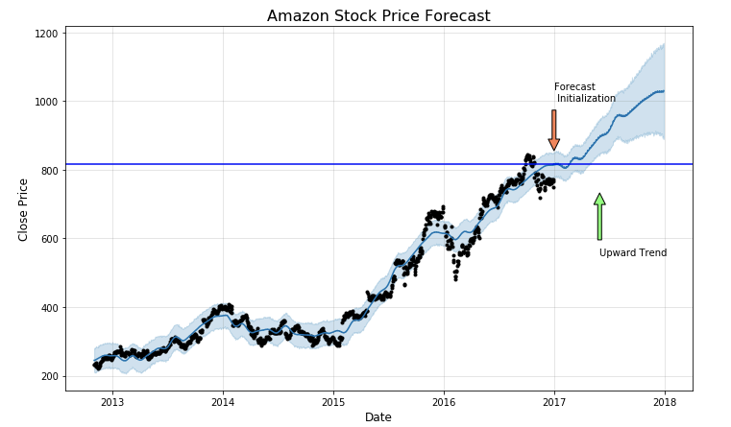
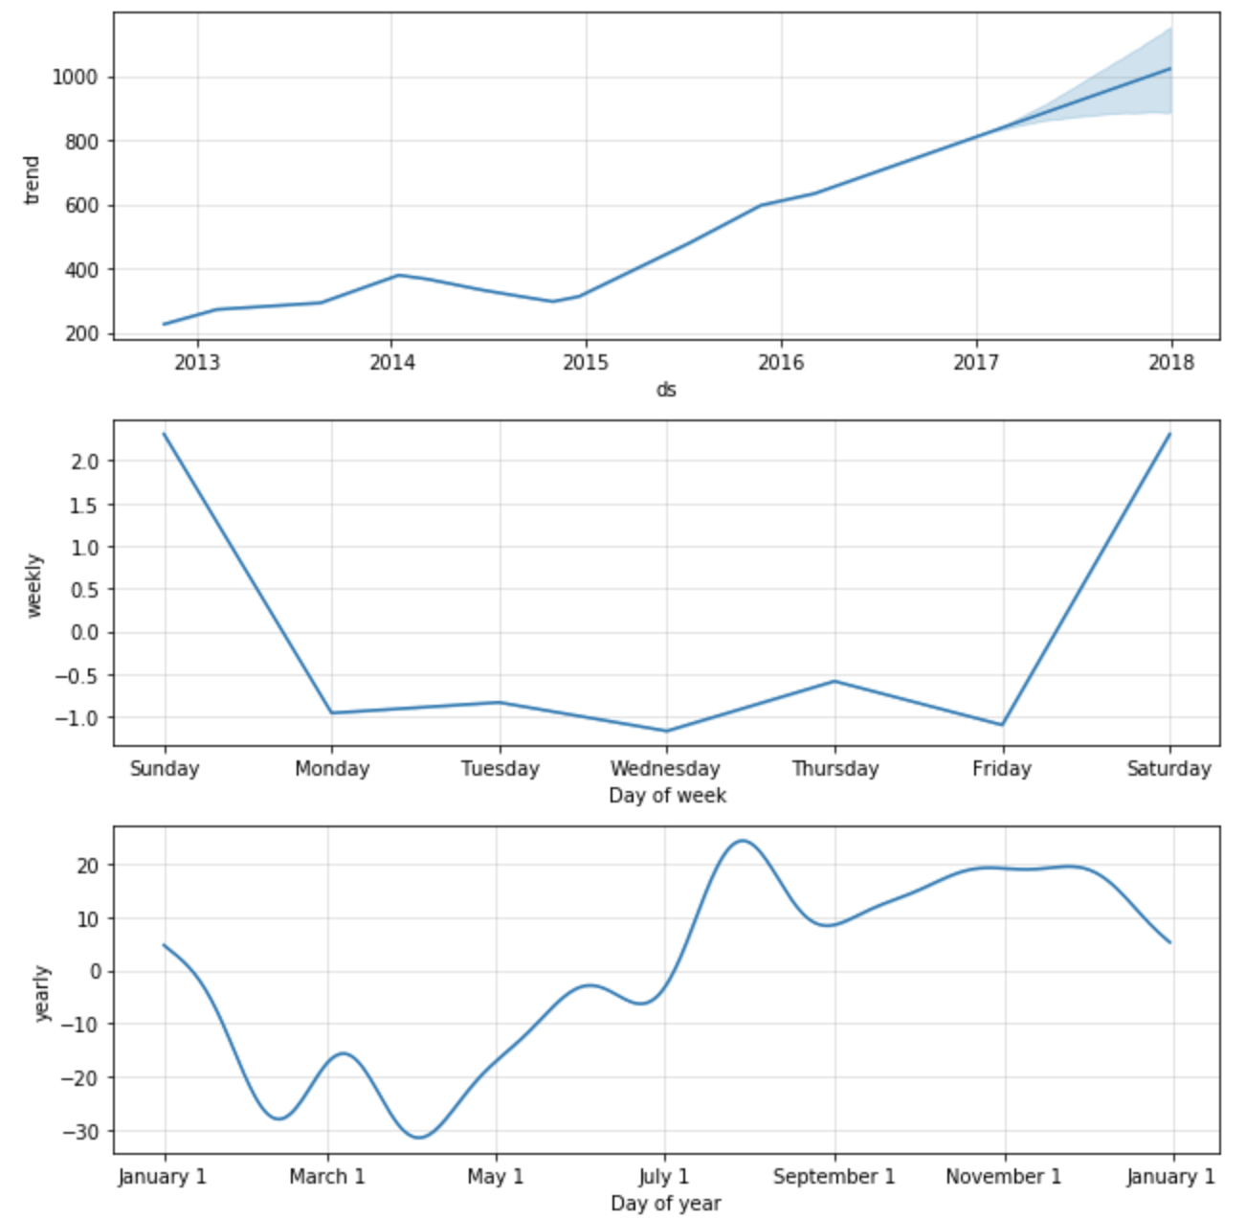
Amazon Stock Forecast Output

Slide 18
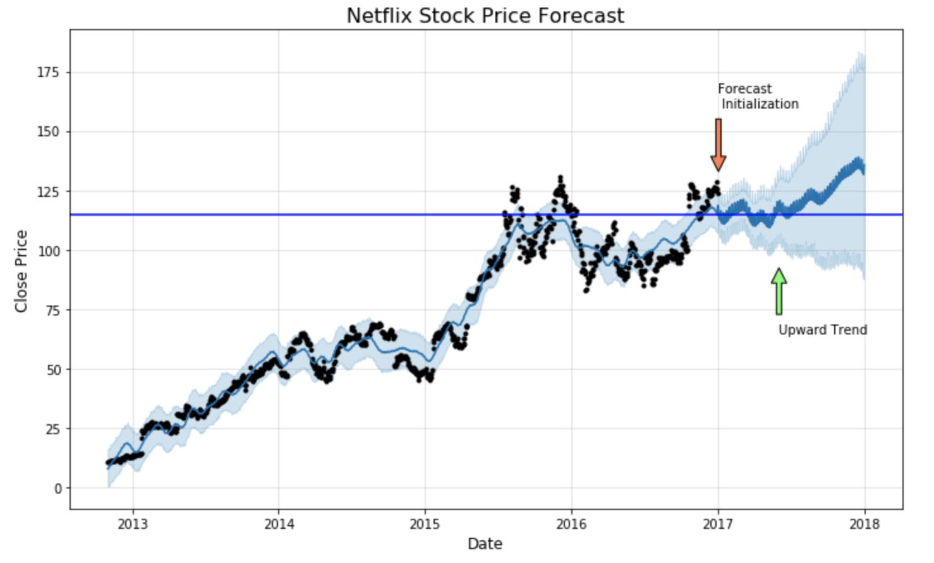
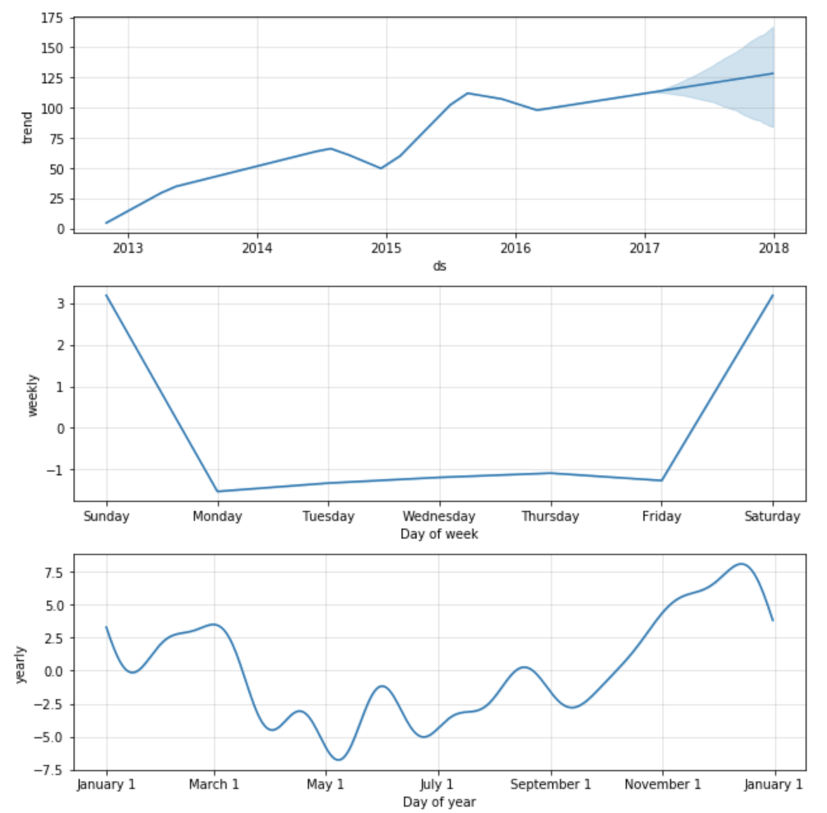
Netflix Stock Forecast Output

Slide 19
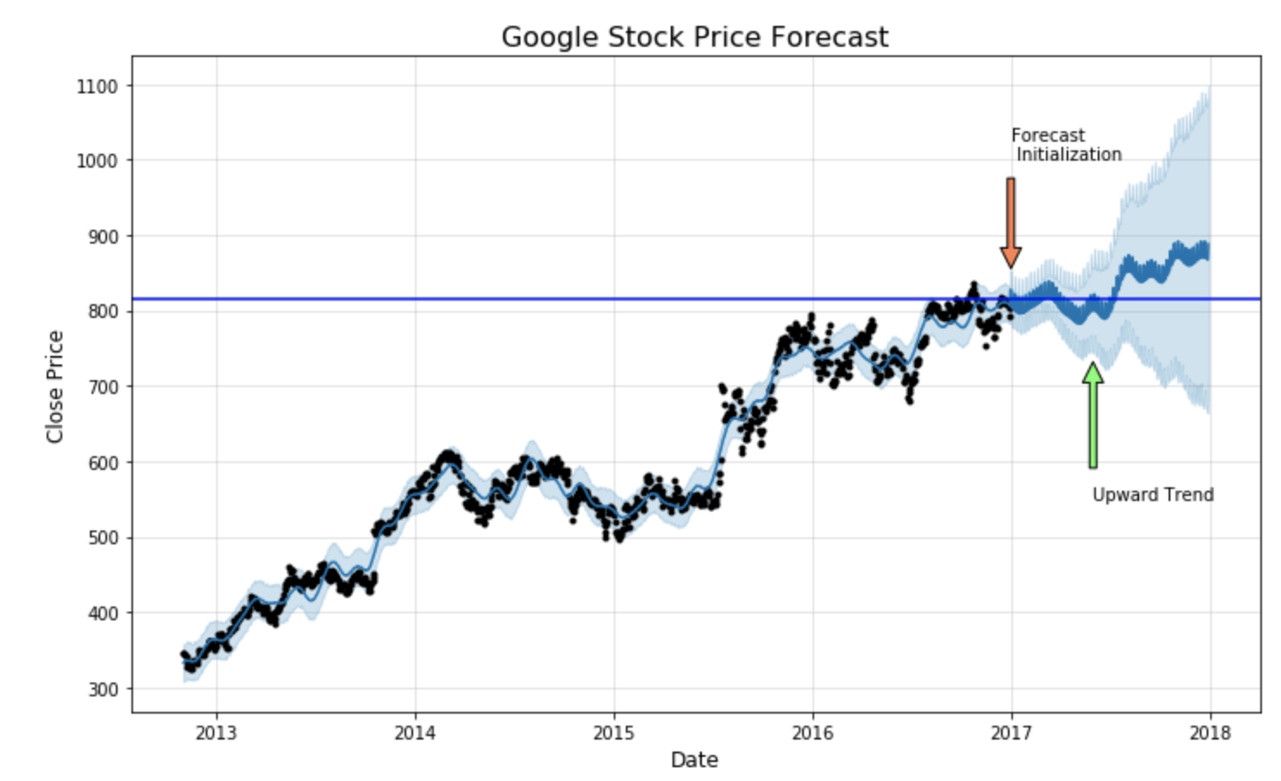
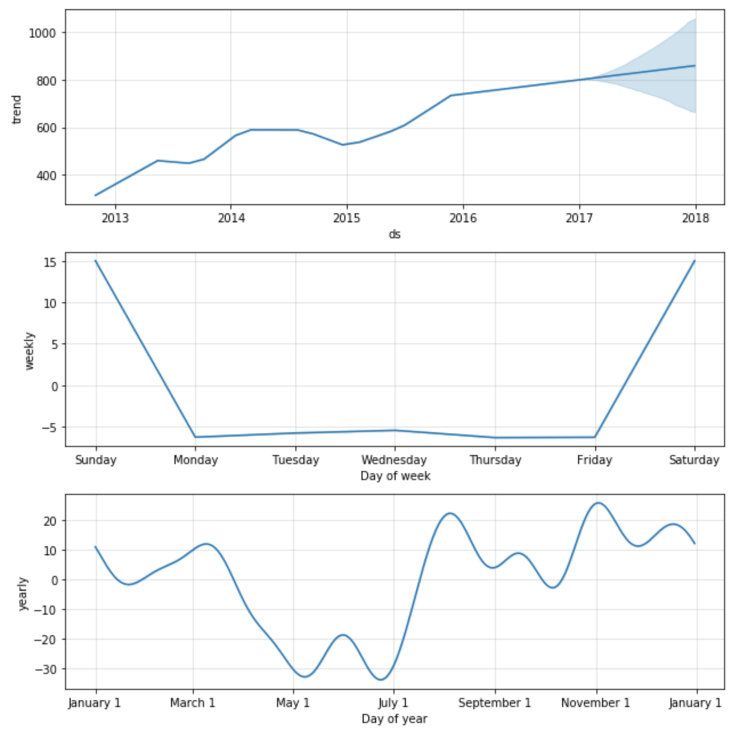
Google Stock Forecast Output

Slide 20
Model 2 - LSTM

Slide 21
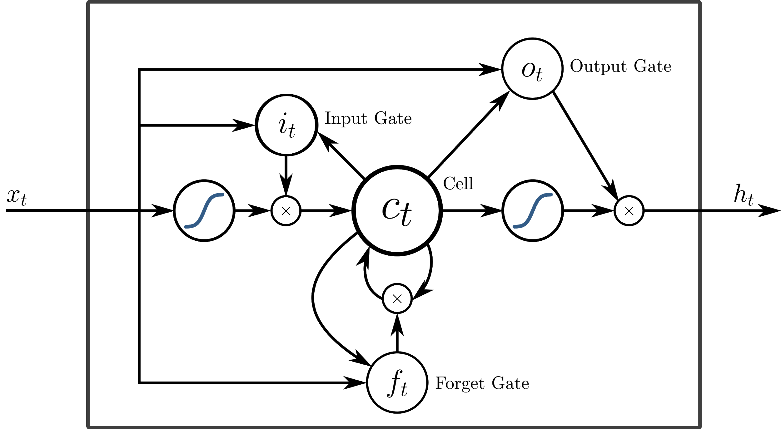
How LSTM works
Long Short-term memory (LSTM) is an artificial recurrent neural network (RNN) architecture used in the field of deep learning.
Forget Gate - f_t
Input Gate - i_t
Output Gate - o_t
How much old memory should be kept into the current LSTM unit
How much new memory should be added into the old memory in the current LSTM unit
How much new memory should output to the next LSTM unit
Notes:
Installation instruction for fb prophet: https://facebook.github.io/prophet/docs/installation.html
At its core, the Prophet procedure is an additive regression model with four main components:
1. A piecewise linear or logistic growth curve trend. Prophet automatically detects changes in trends by selecting changepoints from the data.
2. A yearly seasonal component modeled using Fourier series.
3. A weekly seasonal component using dummy variables.
4. A user-provided list of important holidays
https://facebook.github.io/prophet/

Slide 22
Advantages
Well-suited for time series data
Better in dealing with lags of unknown duration between important events in a time series.
LSTM
Quickly Response
Predict time series trend very fast in normal computer.

Slide 23
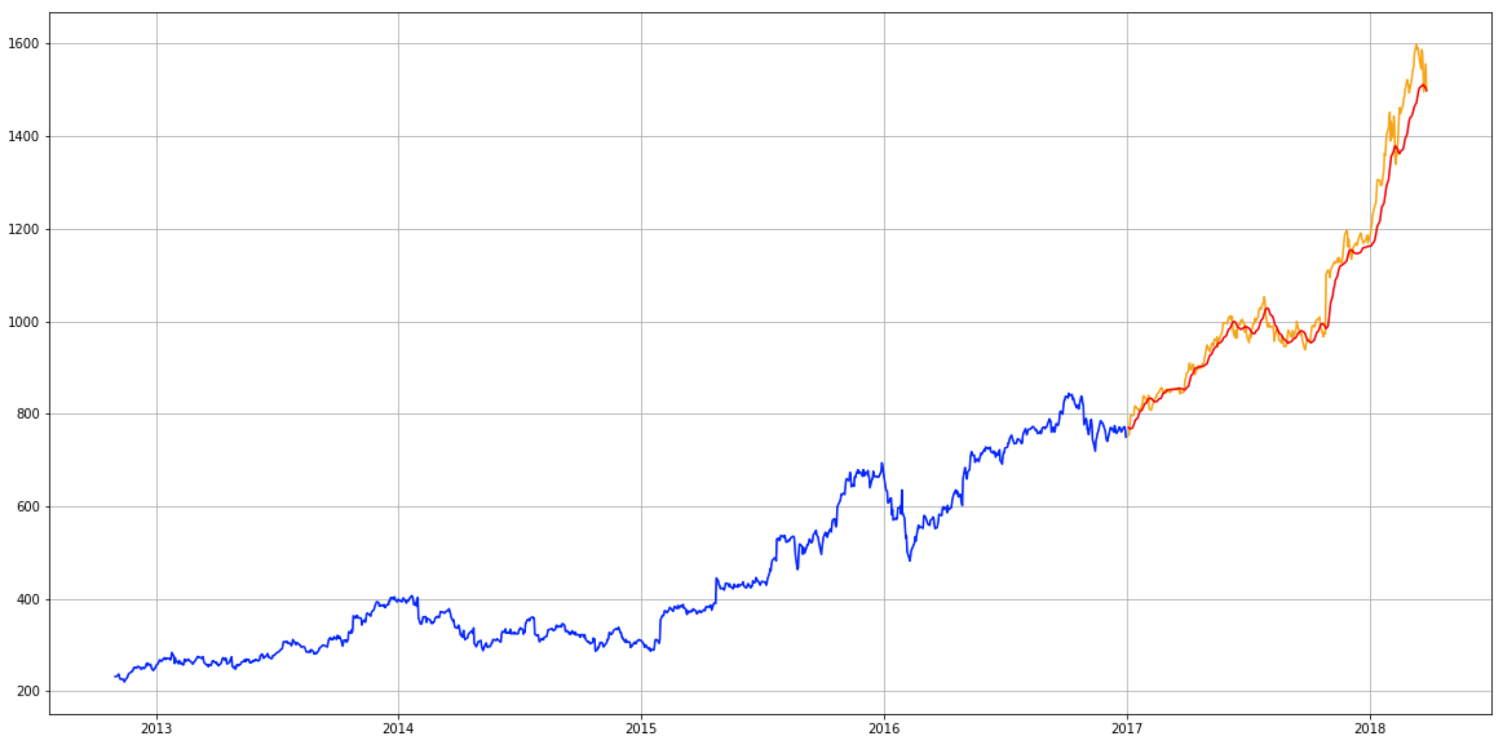
Amazon Forecast Output

Slide 24
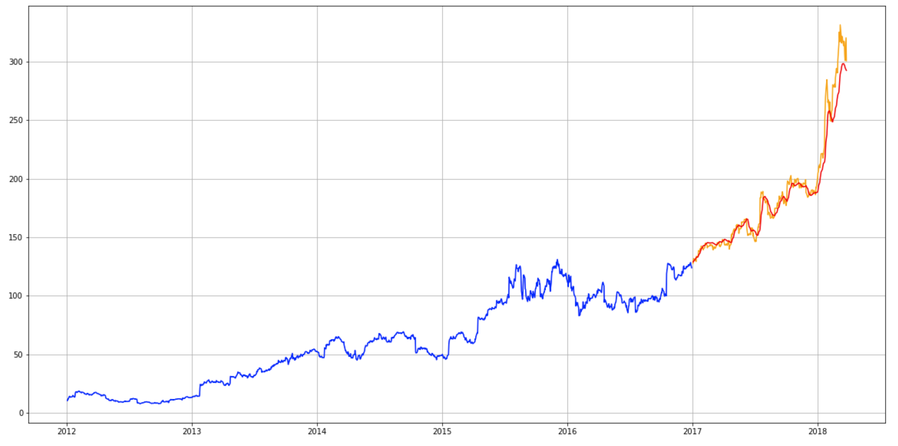
Netflix Forecast Output

Slide 25
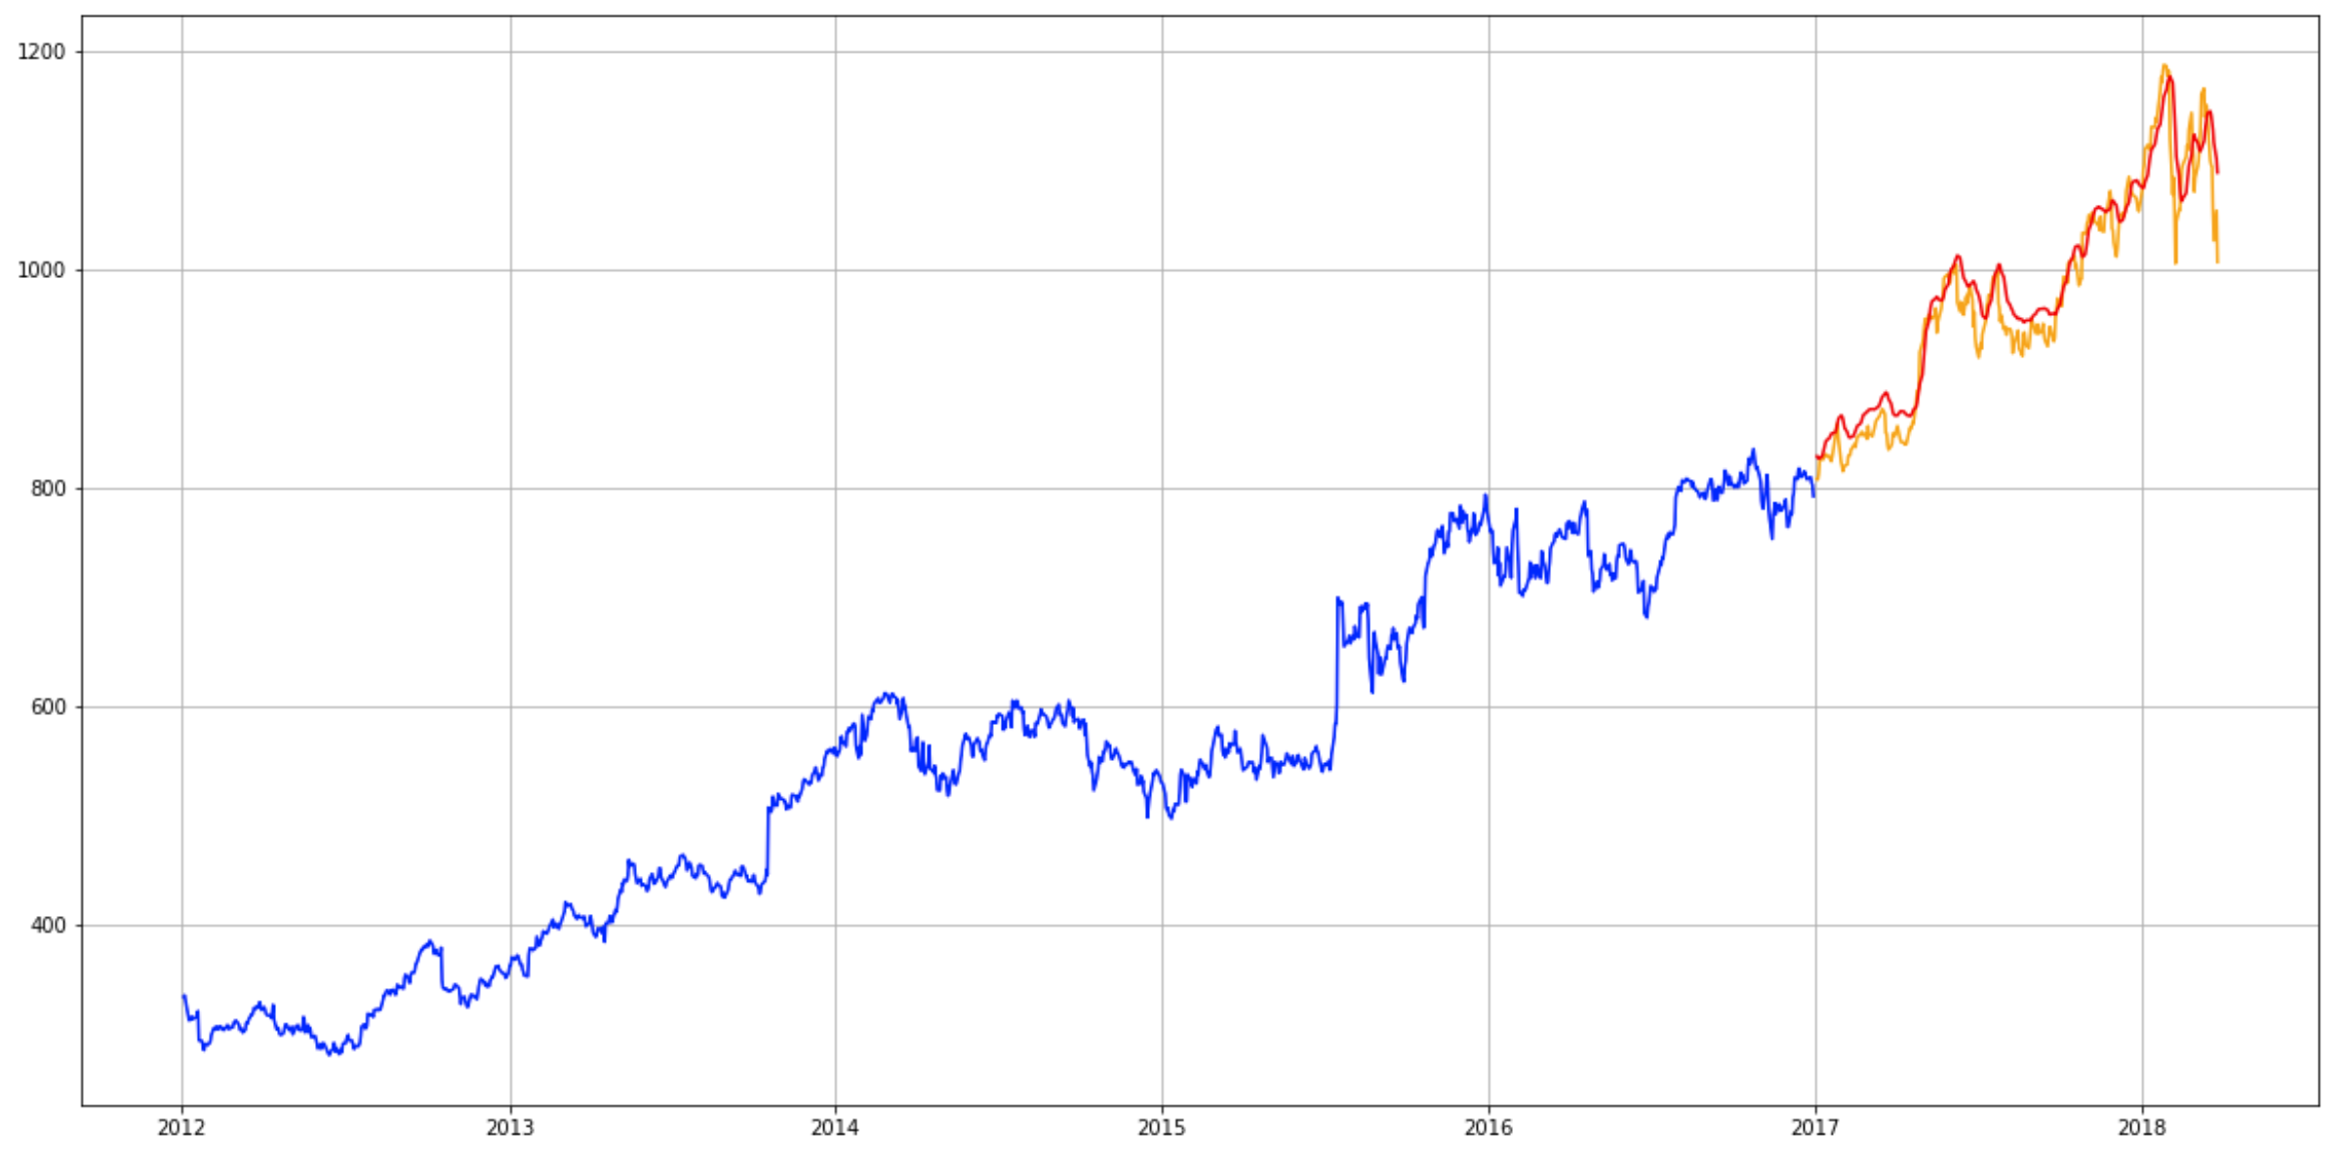
Google Forecast Output

Slide 26
Model 3 - Monte Carlo simulation

Slide 27
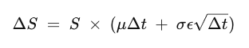
How Monte Carlo simulation works
Monte Carlo simulation is an attempt to predict the future many times over. It attempts to predict the worst likely loss for a portfolio given a confidence interval over a specified time horizon.
Geometric brownian model(GBM)
Random trials
Process output
Generate random trials
The simulation produces a distribution of hypothetical future outcomes
S=the stock price
ΔS=the change in stock price
μ=the expected return
σ=the standard deviation of returns
ϵ=the random variable
Δt=the elapsed time period
​

Slide 28

Advantages
Simple and Straightforward
The convergence can be guaranteed by the theory
Good for optimization problem
Often can reach global optimum and overcome local extreme
Widely used
The method can be used for stochastic (involve probability) and deterministic (without probability)

Slide 29
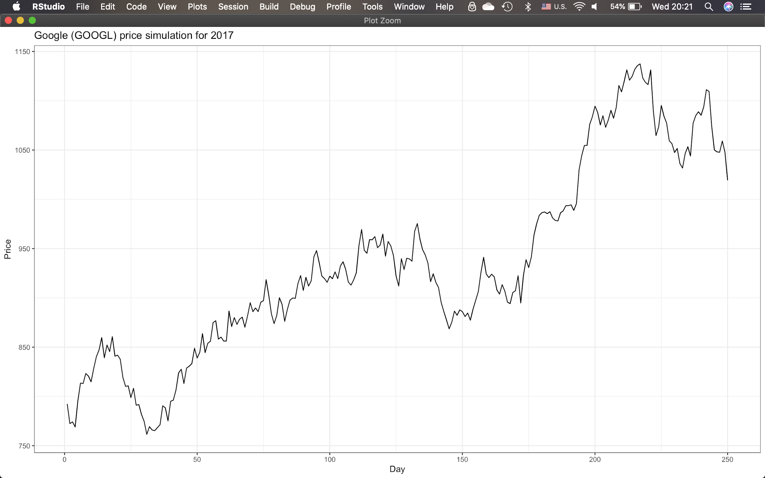
Google Forecast Output

Slide 30
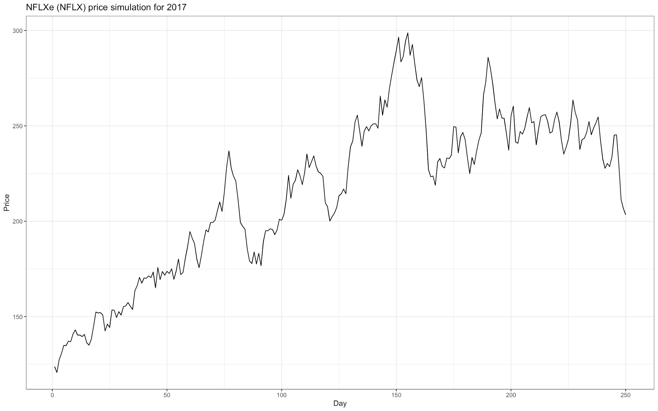
Netflix Forecast Output

Slide 31
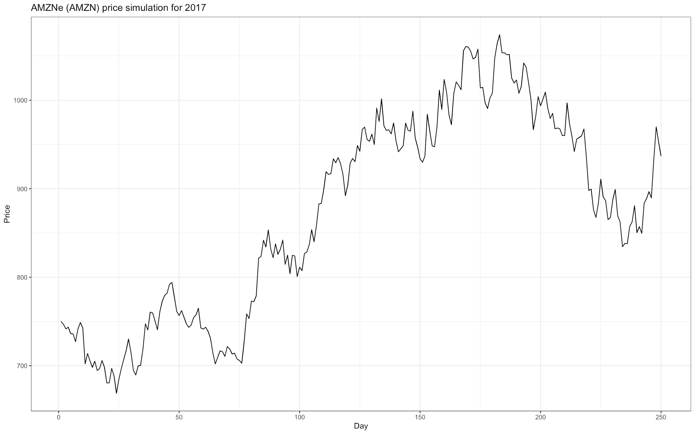
Amazon Forecast Output

Slide 32
Model comparison -
 | R squared value | Mean squared error | Mean absolute error
FB Prophet | 97.6% | 1667.2 | 28.7
LSTM | 96.0% | 1791.5 | 30.1
Monte Carlo | 65% | 15702 | 163

Slide 33
Model comparison - Google
 | R squared value | Mean squared error | Mean absolute error
FB Prophet | 89.7% | 3547.8 | 34.49
LSTM | 92.5% | 710.5 | 20.5
Monte Carlo | 63% | 2074.5 | 37.5

Slide 34
Model comparison - Netflix
 | R squared value | Mean squared error | Mean absolute error
FB Prophet | 78.8% | 494.7 | 12.9
LSTM | 94.4% | 133.6 | 7.0
Monte Carlo | 60% | 2453 | 50

Slide 35
Conclusion
Model | Advantages | Disadvantages
LSTM | 1. Less prone to variance due to seasonality 2. Considers the current trend | 1. Doesn’t consider holidays and events 2. Doesn’t work very well with missing data and shifts in trends
FB Prophet | 1. Works best with time series that have strong seasonal effects and several seasons of historical data 2. Robust to missing data and shifts in the trend 3.Handles outliers well | 1. Applicable data is limited 2. Cannot predict major events or crises that can cause major fluctuations
Monte Carlo | 1.Good for optimization problem 2.Used for stochastic (involve probability) and deterministic (without probability) | 1. Needs lots of data 2. Need to express all the variables with probability distributions 3. Need to model correlation between variables

Slide 36
Appendix

Slide 37
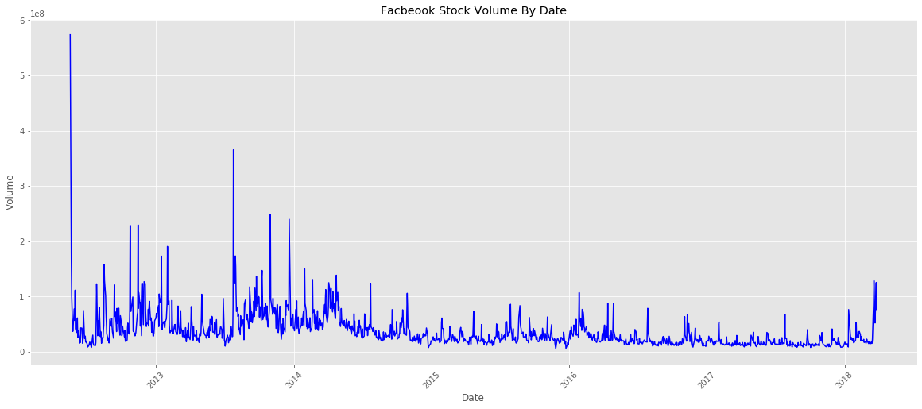
Exploratory Data Analysis -> Facebook(Fb)
Investors scared about slow
growth and aggressive spending
Notes:
https://fortune.com/2016/11/03/facebook-stock/

Slide 38
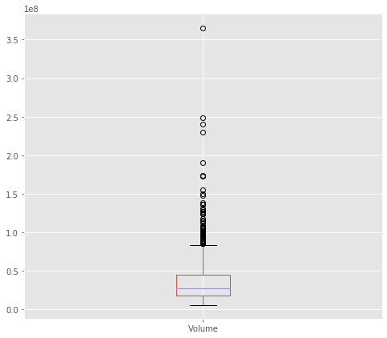
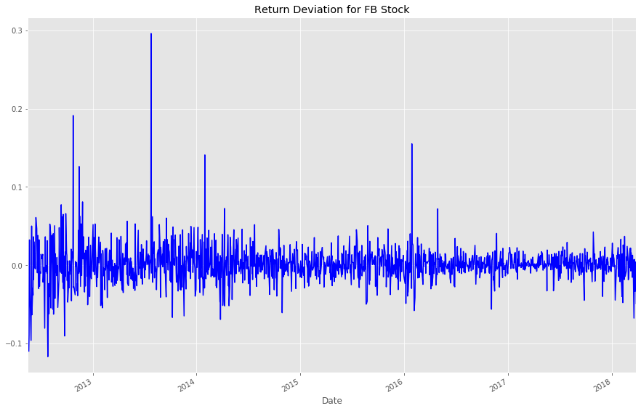
Exploratory Data Analysis -> Facebook(Fb)
Volume Boxplot for FB Stock
Return Deviation Chart
5/18/12 FB IPO
7/25/13
Volume: 365,458,000
7/25/13 Strongest Quarter
Volume: 27181189.5
11/27/15
Notes:
***All values are continuous,
5/8/12 Volume record for an IPO, Third-largest IPO ever after GM and VISA, FB hadall night hackathon the day before
https://money.cnn.com/2012/05/18/technology/facebook-ipo-trading/index.htm
Mobile ad revenue is equal to 41% of all ad revenue
http://buzz.money.cnn.com/2013/07/25/facebook-earnings-stock/
Daily returns: (fb_df['Daily Lag']/fb_df['Close']) - 1

Slide 39
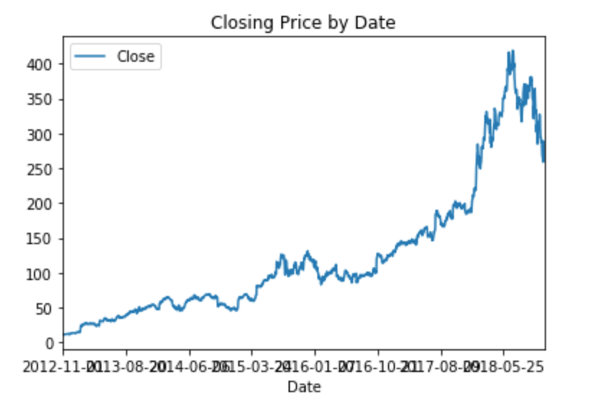
Exploratory Data Analysis -> Netflix
Netflix raising the price of its monthly plan from $9.99 to $11.99

Slide 40
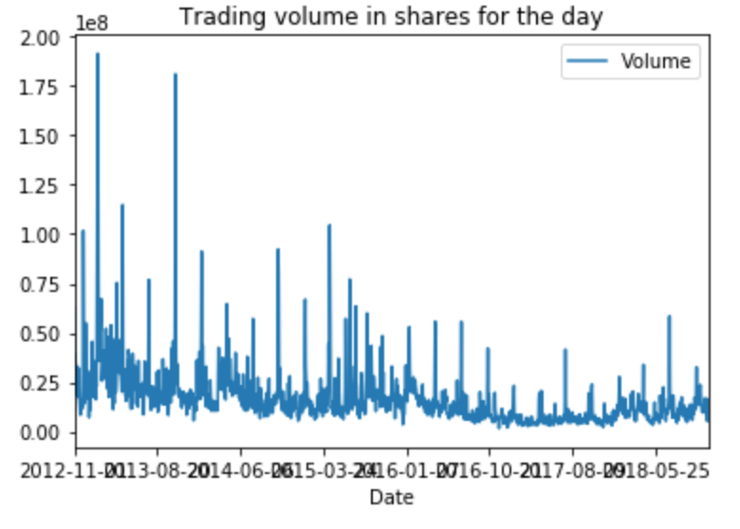
Exploratory Data Analysis -> Netflix
Trading volume in shares during the day, when the stock price spike occurred, also went up. This means investors were confident that the company will do well.

Slide 41
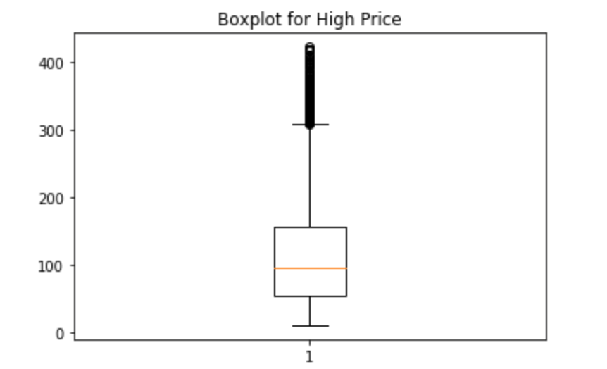
Exploratory Data Analysis -> Netflix

Slide 42
Monte Carlo
https://towardsdatascience.com/monte-carlo-simulations-with-python-part-1-f5627b7d60b0

Slide 43
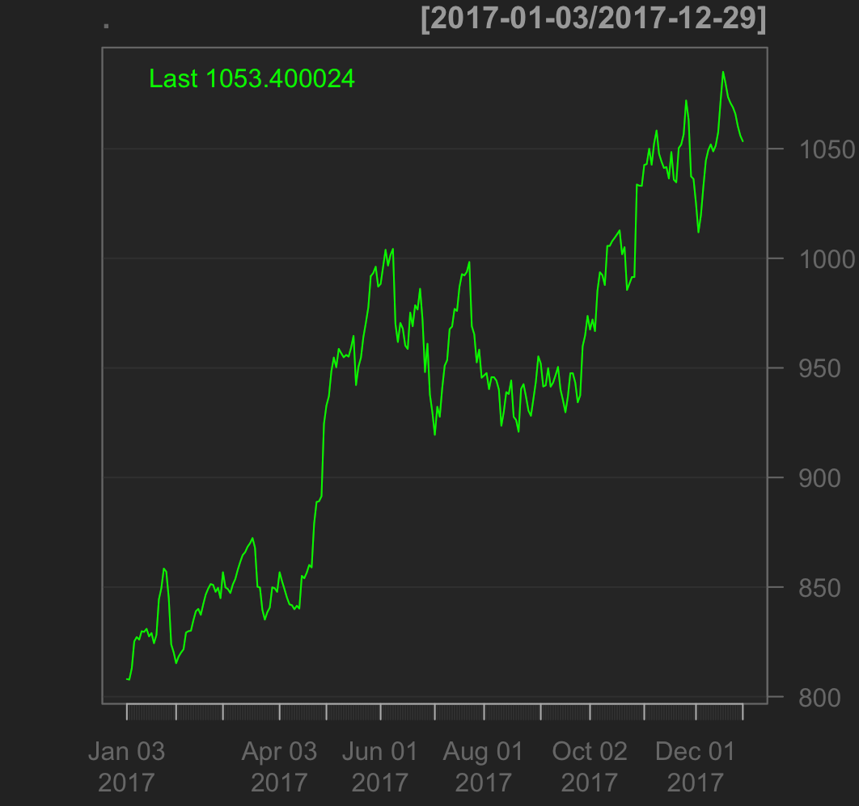
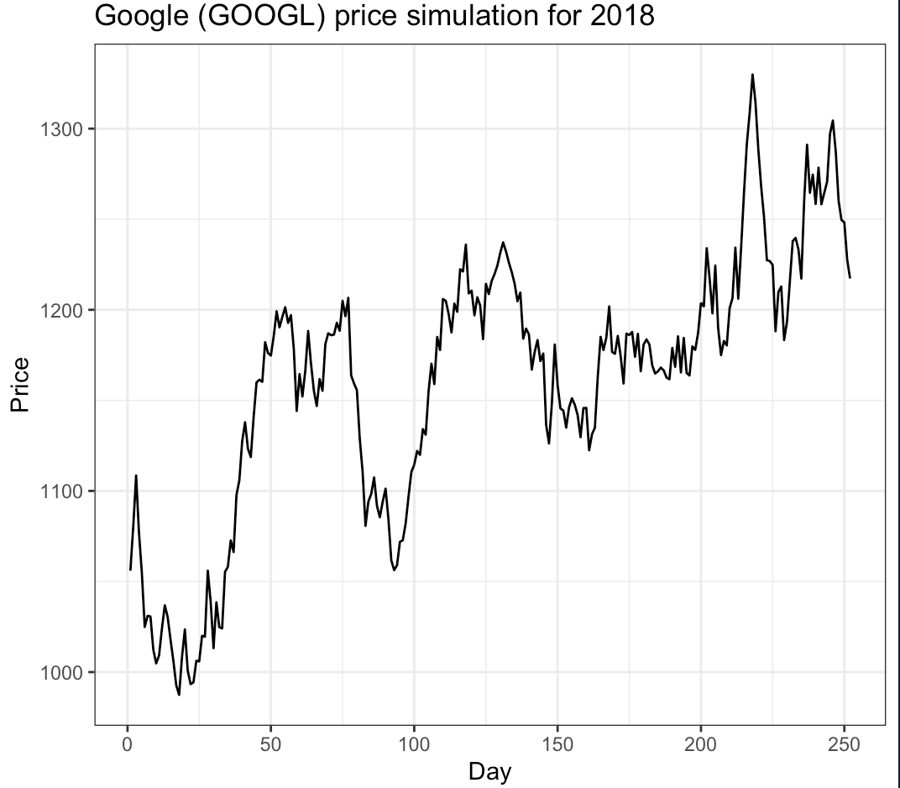
Google Stock
Predicting Data For 2017 of GOOGLE
Real Stock Data For 2017 of GOOGLE

Slide 44
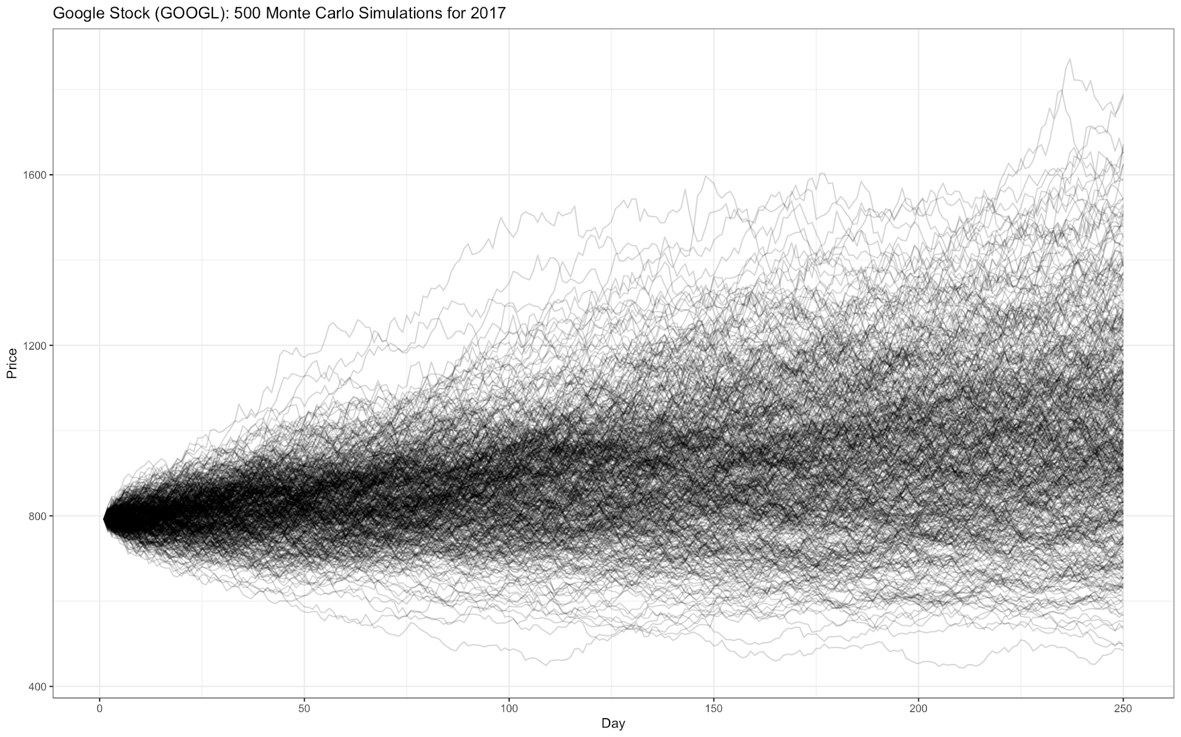
Google Stock
Confidence Interval
In the real stock data for 2017 Google, the closing price of last day was $609.5756, which was in the 95% confidence level ($608.5756-$1536.6943)

Slide 45
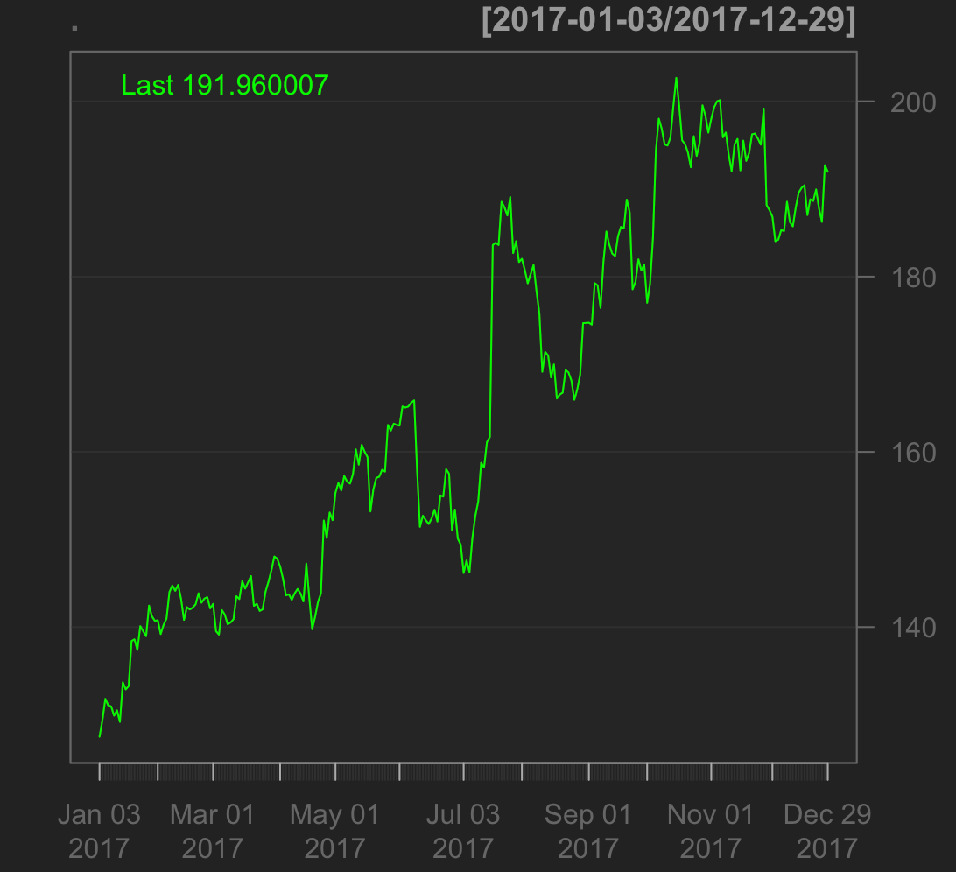
Netflix Stock
Real Stock Data For 2017 of Netflix

Slide 46
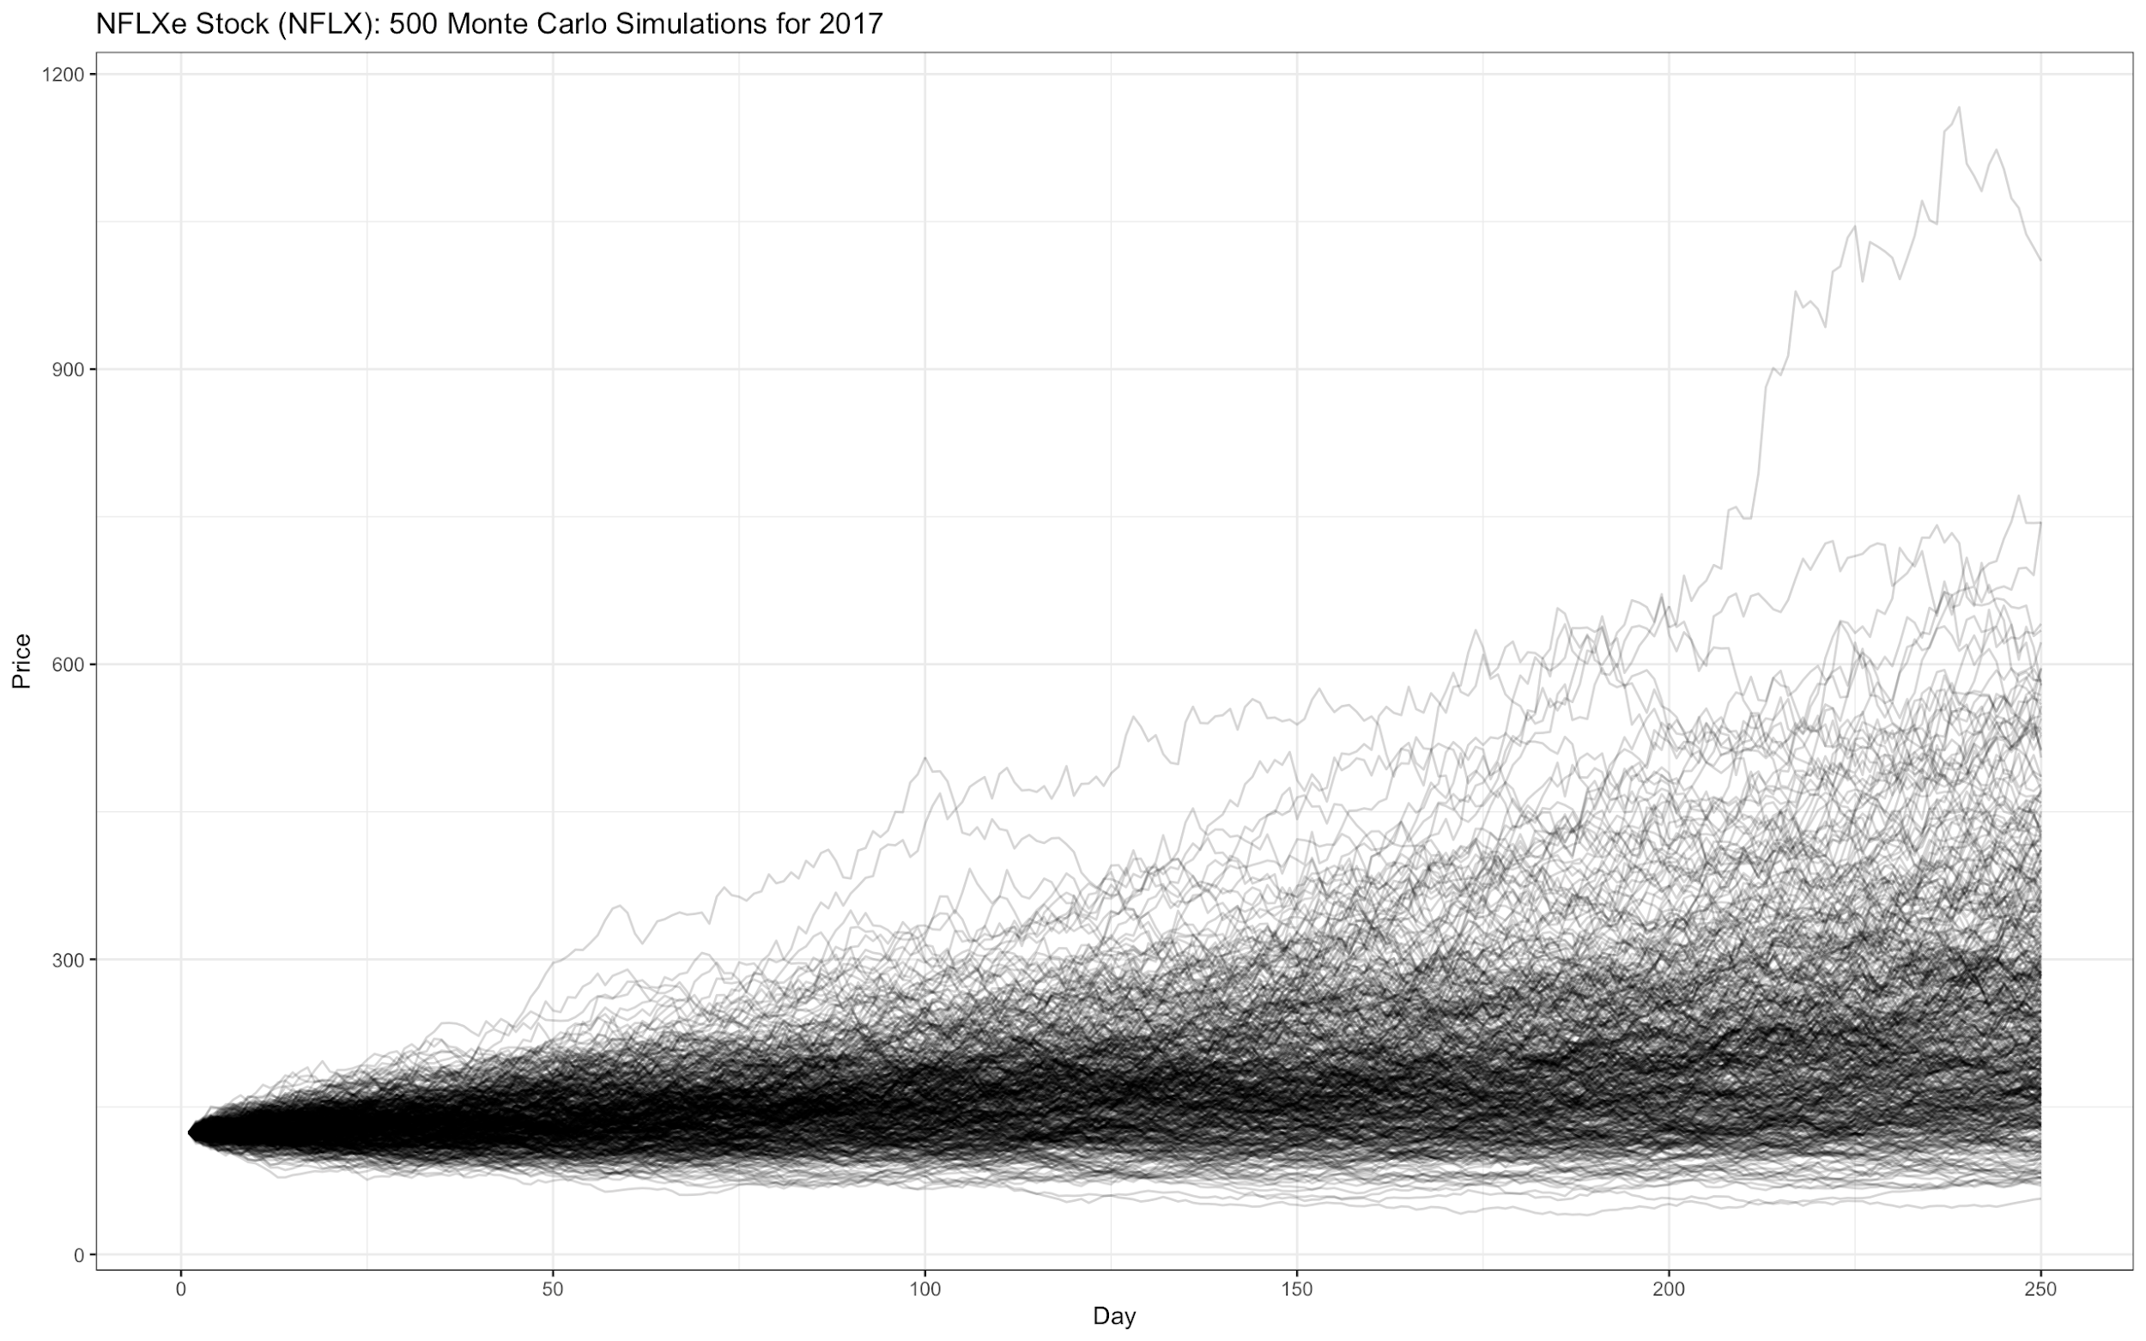
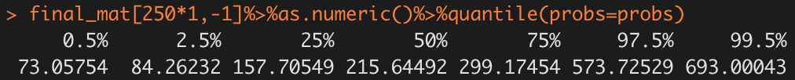
Netflix Stock
Confidence Interval
In the real stock data for 2017 Netflix, the closing price of last day was $191.96, which was in the 95% confidence level ($84.26-$573.75)

Slide 47
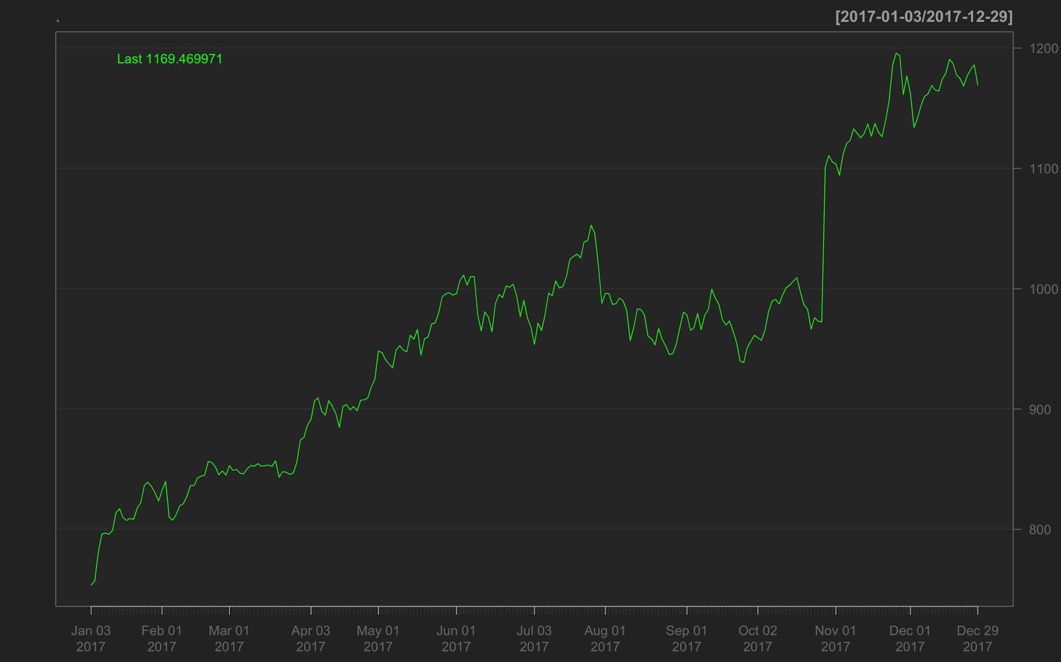
Amazon Stock
Real Stock Data For 2017 of Amazon

Slide 48
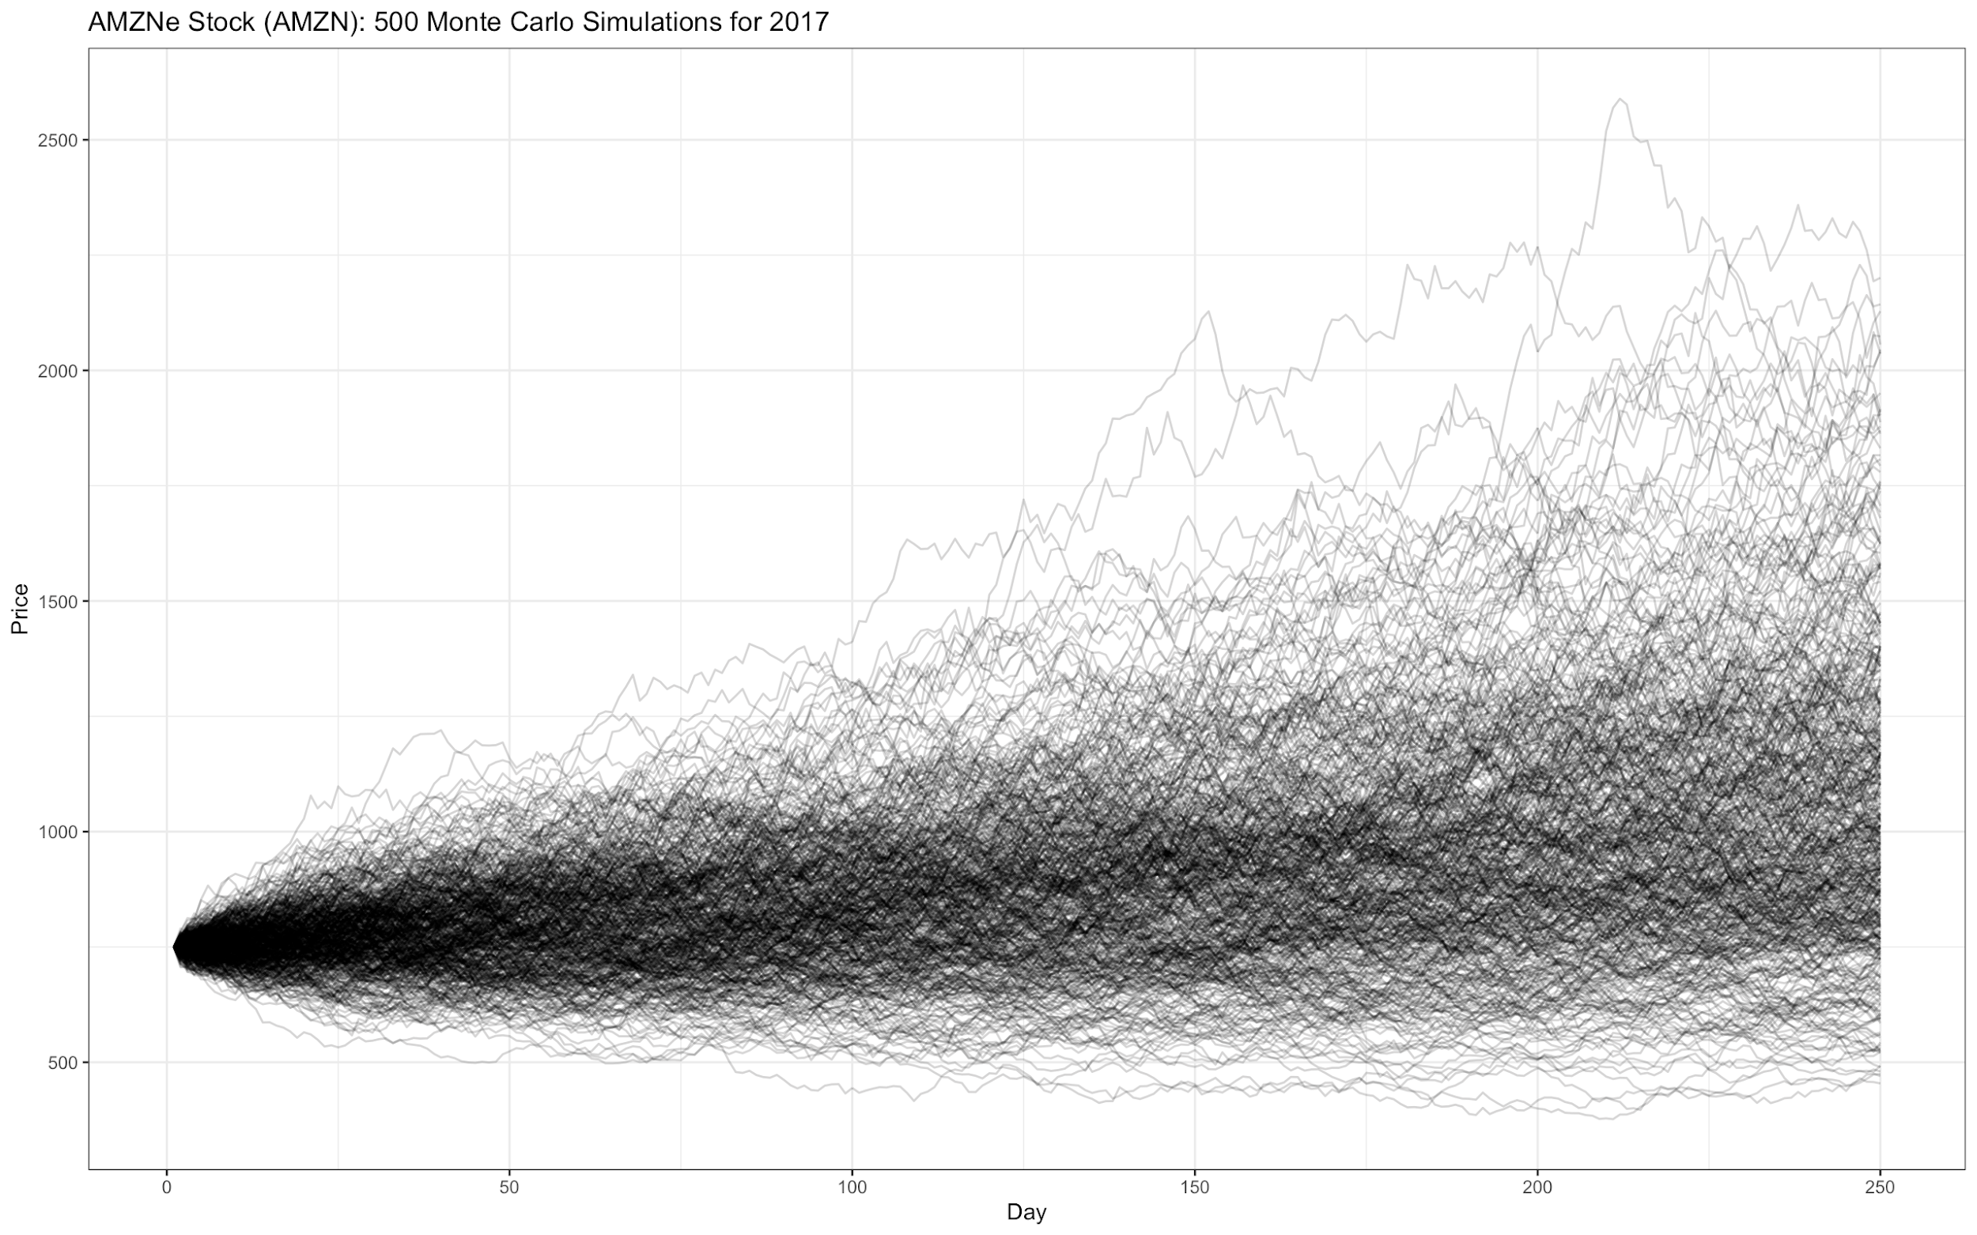
Amazon Stock
Confidence Interval
In the real stock data for 2017 Amazon, the closing price of last day was $1169, which was in the 95% confidence level ($533.5970-$1895.28)

Slide 49
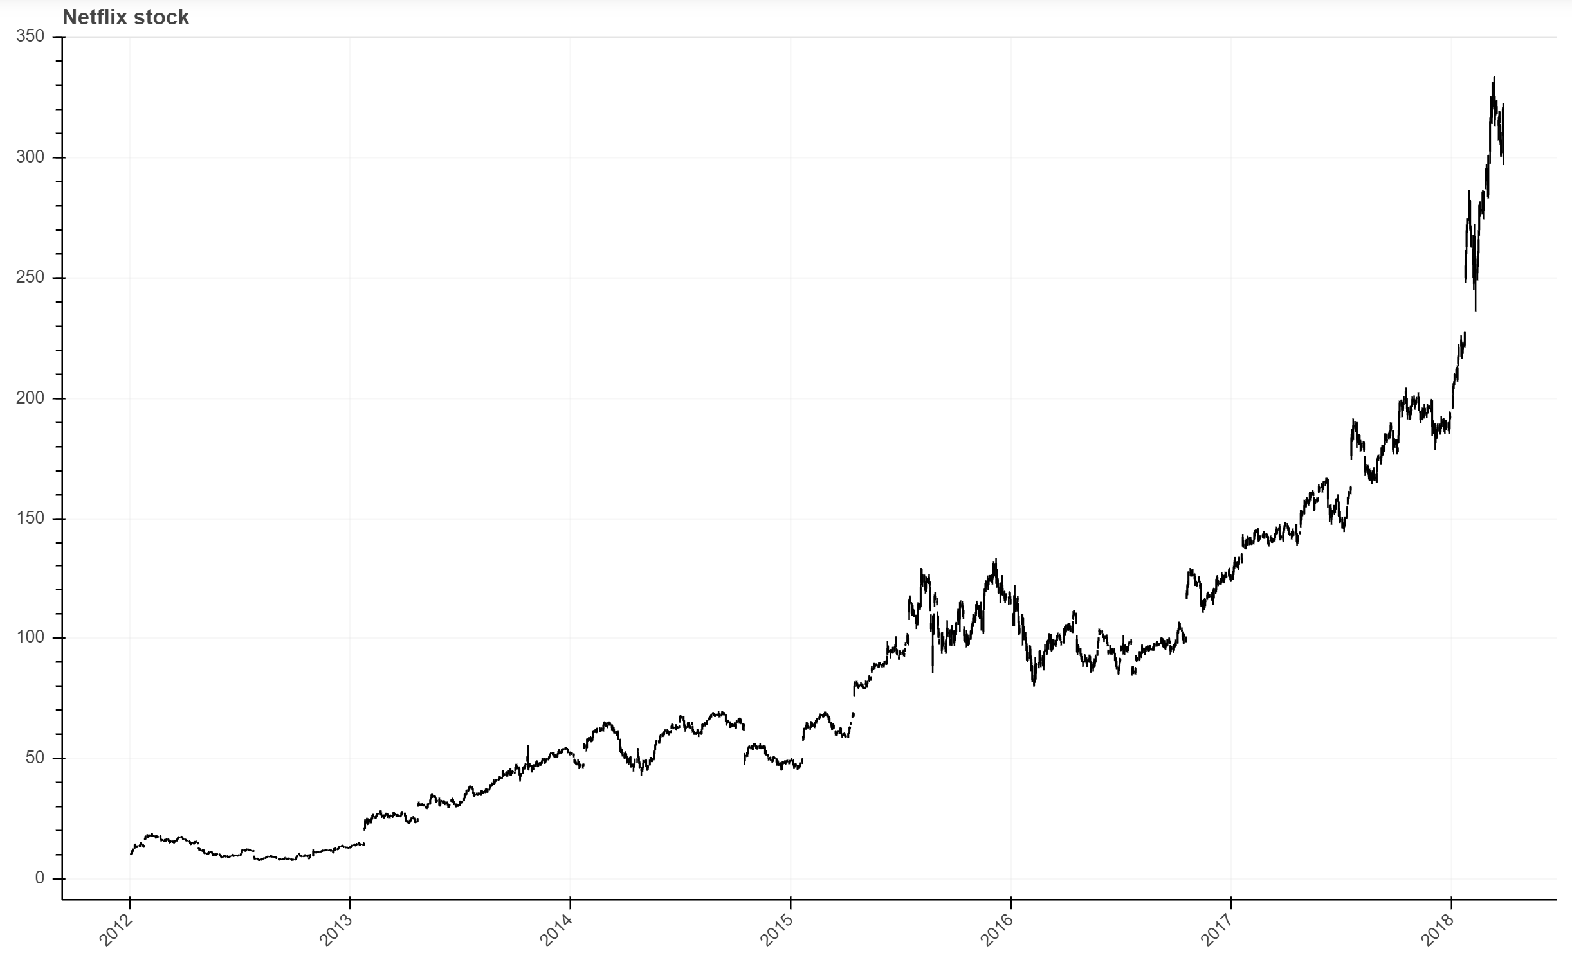
Netflix stock’s Behavior
What happened around that day?

Slide 50
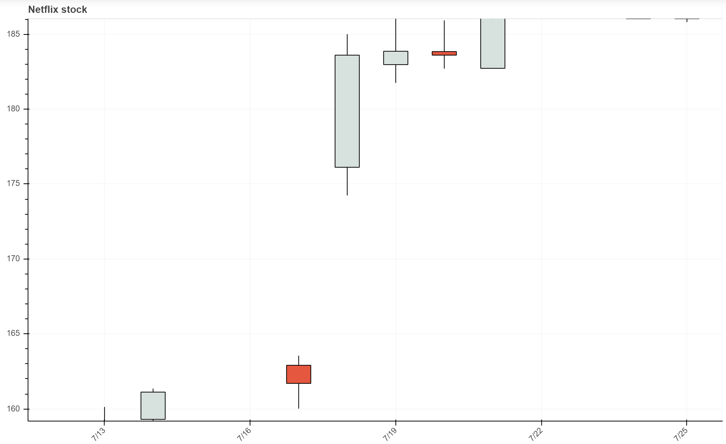

Slide 51
